Slide 1
Grievances' Importance Prediction
By Ius Humanum

Slide 2

What we’re doing
We considered grievances filed across the world and prioritized them by assessing the significance of various articles, constitutional declarations, enforcement and other pertinent resources in relation to the aforementioned grievances
Based on the Hacker Earth Machine Learning Challenge: Resolving citizens’ grievances

Slide 3
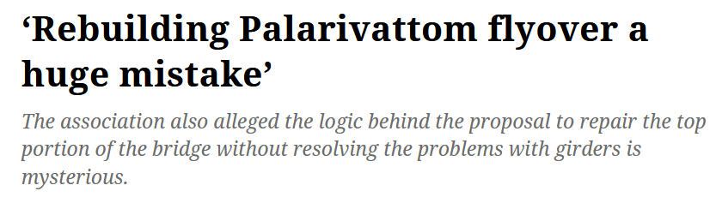


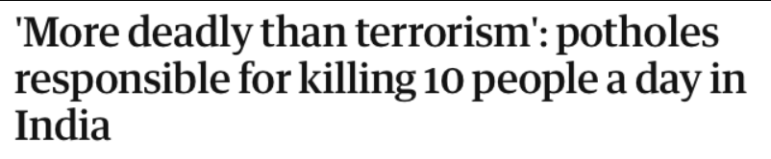


But why?
The current system of public grievance management is inefficient and ineffective, and we feel the effect of this incompetence in our daily lives.
Utilizing this basic program can help many urgent issues get fast-tracked into receiving the attention that they need.

Slide 4

Alright, how do we do this?
Dataset was provided by HackerEarth, and was downloadable from Kaggle.
The Dataset contained information on grievances, their origin, and the issues, applicability, relevant articles, and other pertinent details.
With this data in hand, we were able to successfully apply the concept of machine learning to the problem

Slide 5
Getting to the crux of the matter
To successfully apply machine learning to this problem, a series of steps needs to be followed to obtain an efficient and optimal machine learning model.
Step 1: To install the prerequisites
Step 2: Loading in the datasets and Feature Engineering on the dataset
Step 3: Selecting and Training the model
Step 4: Uploading to HackerEarth
The code was run on Google Colab, as it took too long to compute on our local system.

Slide 6
Installing the prerequisites for our program
Python 3.6+ is required to run this program. It can be downloaded from the official website (www.python.org)
Once python and pip are installed, the following python packages need to also be installed
Numpy #Mathematical Operations on the dataset
Pandas #Manupulation of the Dataset
Scikit learn #Dataset pre-processing and training
Light GBM #Algorithm Used
To install all of these in one command using pip, the following command can be run in the command prompt:
pip install numpy, pandas, sklearn, lightgbm

Slide 7
Loading the dataset and feature engineering
We used pandas to read the dataset into manipulatable data frames.
To get a better feel of the data in the provided dataset, we combined the train and test set into a single data frame, on which we ran multiple functions to process our features into more meaningful and useful data.
After manipulating, creating, combining, and dropping features, we finally had a processed data frame which could be used by scikit learn and light gbm to apply their respective algorithms
The initial dimensions of the dataset had 328 columns, which was later reduced to 294 columns after performing feature engineering

Slide 8
Training the model
We tried running our data on 3 different algorithms, Random Forest, Light GBM, and Decision Tree Classifiers. We achieved the best accuracy with Light GBM.
We used Grid Search CV to iterate through many different hyperparameters to find the best ones, to get the best accuracy possible
The best hyperparameters achieved were:
Learning rate: 0.01
N_estimators: 1022
Max_depth: 7
Max_features: 3
We cross validated our model and got an average score of 87.7%

Slide 9
Uploading to HackerEarth
As this problem statement was from HackerEarth, the solution was uploaded and was evaluated by them
According to their instructions: “Your output will be evaluated only for 50% of the test data while the contest is running. Once the contest is over, output for the remaining 50% of the data will be evaluated and the final rank will be awarded.”
We achieved a score of 88.23390% on our solution, and were awarded 21st position on the leaderboard, when the top spot was an accuracy of 89.73280%
This hackathon is still running, and the final rank has not been determined

Slide 10
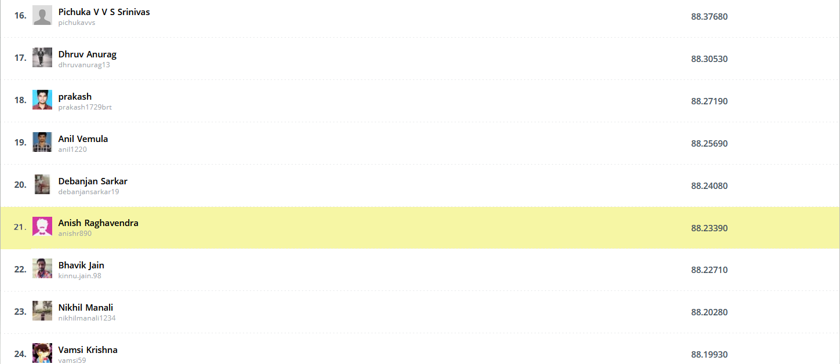

Slide 11
But can we do better?
This is a headless program, and to change the hyperparameters, the program itself should be changed, which isn’t optimal.
The program could have a GUI or a web interface, with which it would be more easier to interact with the program
This ML program was built so as to assess the importance of a case, but there is no provision to input a case details to check its importance. Given time, a feature could be easily implemented, which would take case details of either a singe case or a csv of new cases, and predict their importance
From a management perspective, a new system would have to be put in place to address the important issues while still not neglecting the less important issues

Slide 12
Did we have fun?
We learned a lot in this hackathon, starting from coding on the google colab platform, to the right steps in implementing machine learning to a problem
We learned how to manage a project on git while working with other members of the team
We learned to work as a team and split tasks between ourselves and work efficiently while also having an amazing time
This was an amazing ice breaker experience, and we made a lot of friends and inside jokes on the way, and we thank DSC-VIT for the opportunity to take part in this hackathon

Slide 13
Thank you!
Anish Raghavendra
Ananya Elizabeth George
Raggav Subramani
Rehaan Mazid
From Team Ius Humanum

